Slide 1
CRUMBL COOKIE INVENTORY MANAGEMENT
IST 659 FINAL PROJECT
Presented by:
Collin Taylor
Kishan Rathor
Under the guidance of:
Prof Michael Fudge

Slide 2
OVERVIEW
Our goal for this project was to create an inventory management database using data that we created to simulate operating a cookie bakery.
The Database has Data for
Stores, Payroll, Departments, Employees, Products, Inventory, Inventory Invoices, Customers, Credit Cards, Cookie Sales
In todays world, every business must manage its inventory, which uses up a lot of resources. Hence we created an inventory management system to address this issue for business.

Slide 3
TABLE OF CONTENTS
User Stories
Technologies Used
ERD Data Requirements
Entity relationship data requirements/business rules
Conceptual Model
Logical Model
Demo of UI & Layout
Table Data
Conclusion

Slide 4
USER STORIES
The app user (manager) must be able to view the Employees within all departments and their respective pay rate in order to accurately pay their employees for the work performed.
The app user (owner) must be able to list new items on the menu to maintain corporate’s expectations of a rotating menu each week so that customers always have a fresh selection of cookies.

Slide 5




TECHNOLOGIES USED

Slide 6
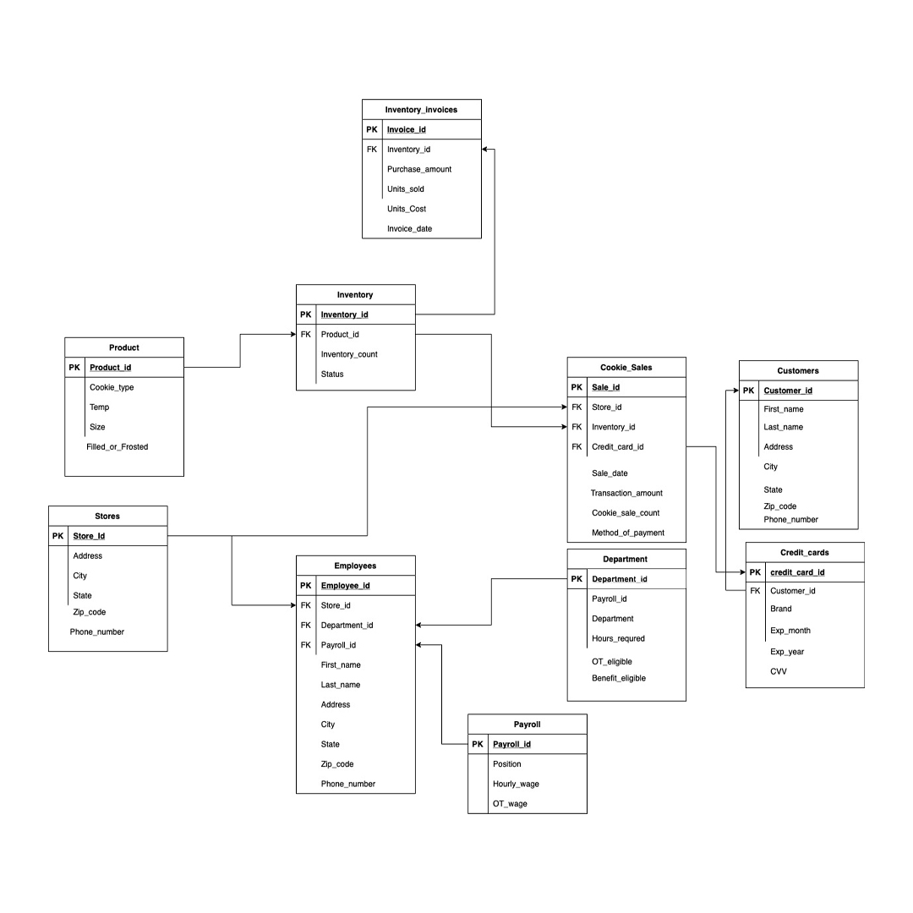
CONCEPTUAL MODEL
Conceptual model includes the requirements needed to
Create the database
High level description

Slide 7
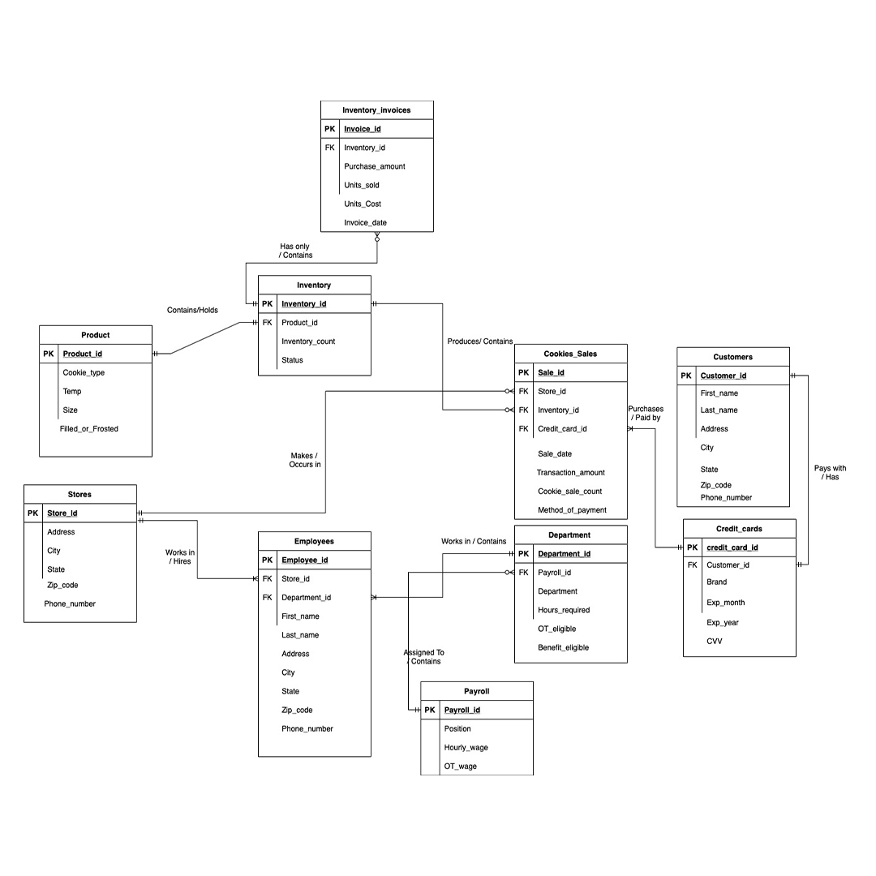
LOGICAL MODEL
Logical Model includes representations of the entities, attributes and their relationships

Slide 8
DEMO OF THE UI & LAYOUT

Slide 9
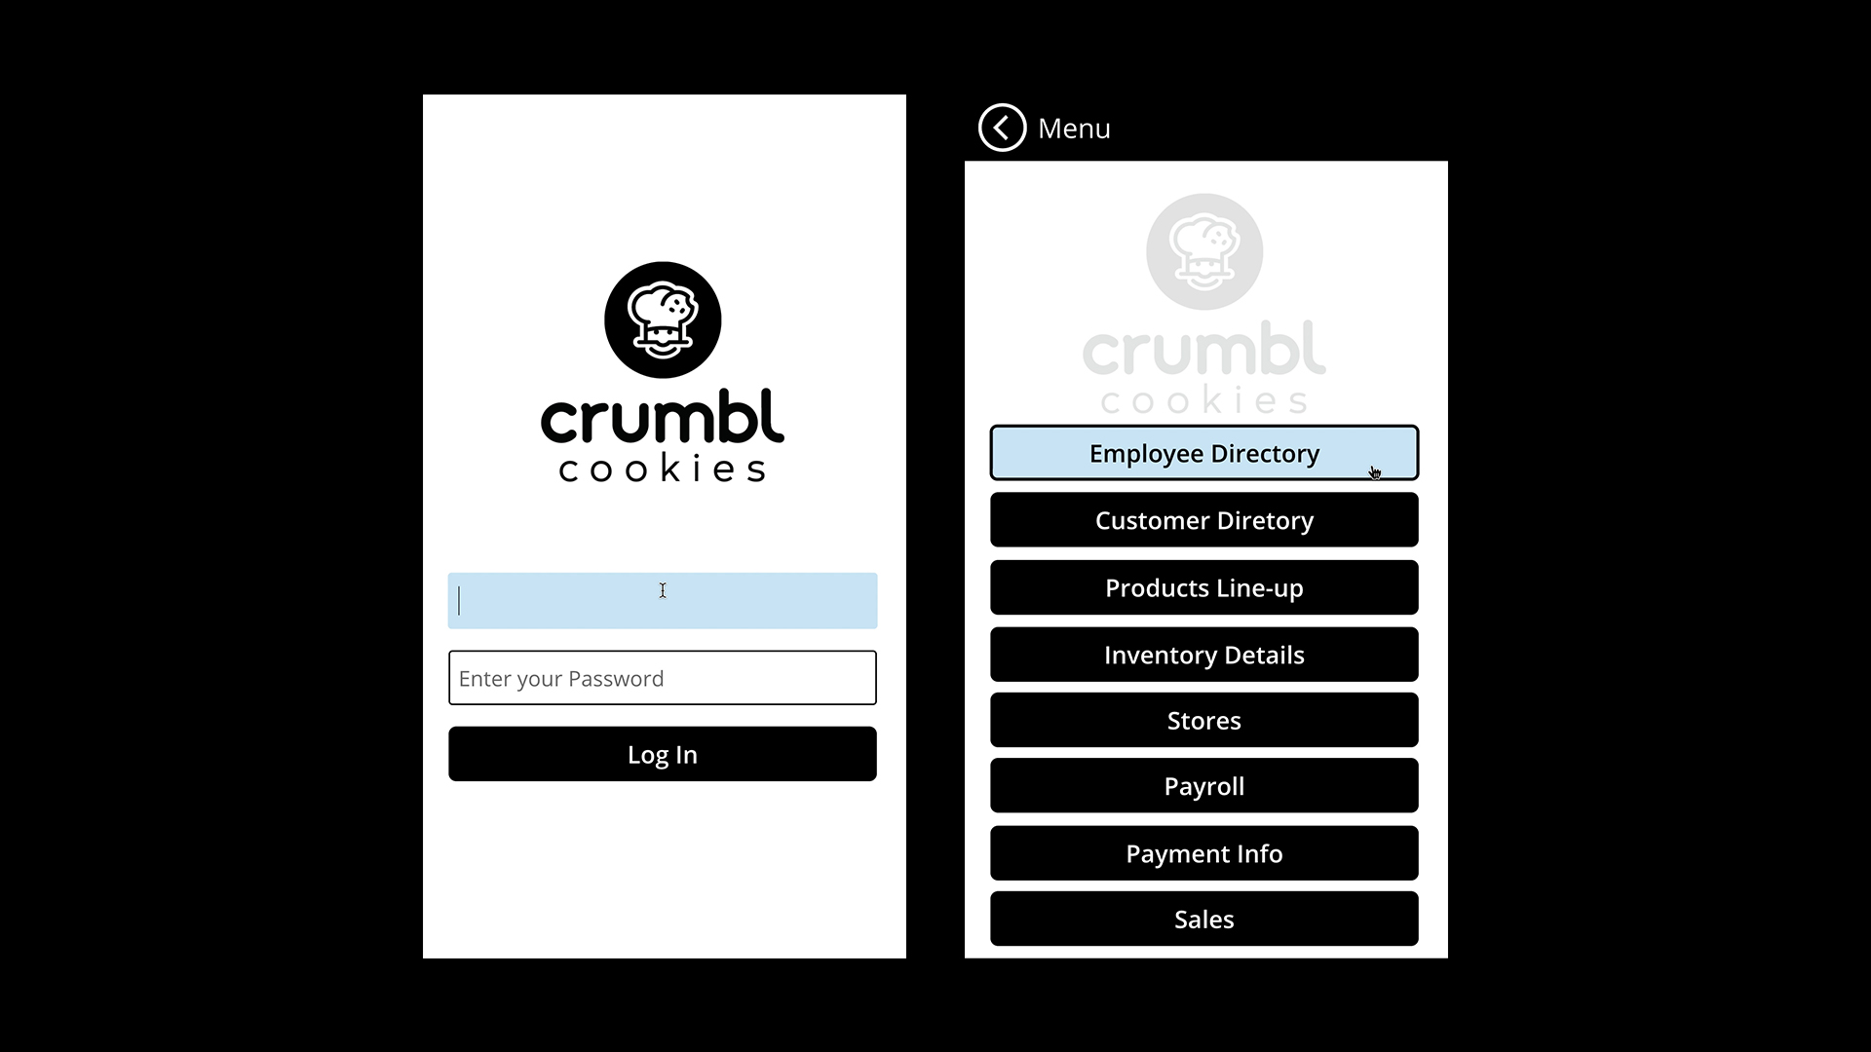

Slide 10
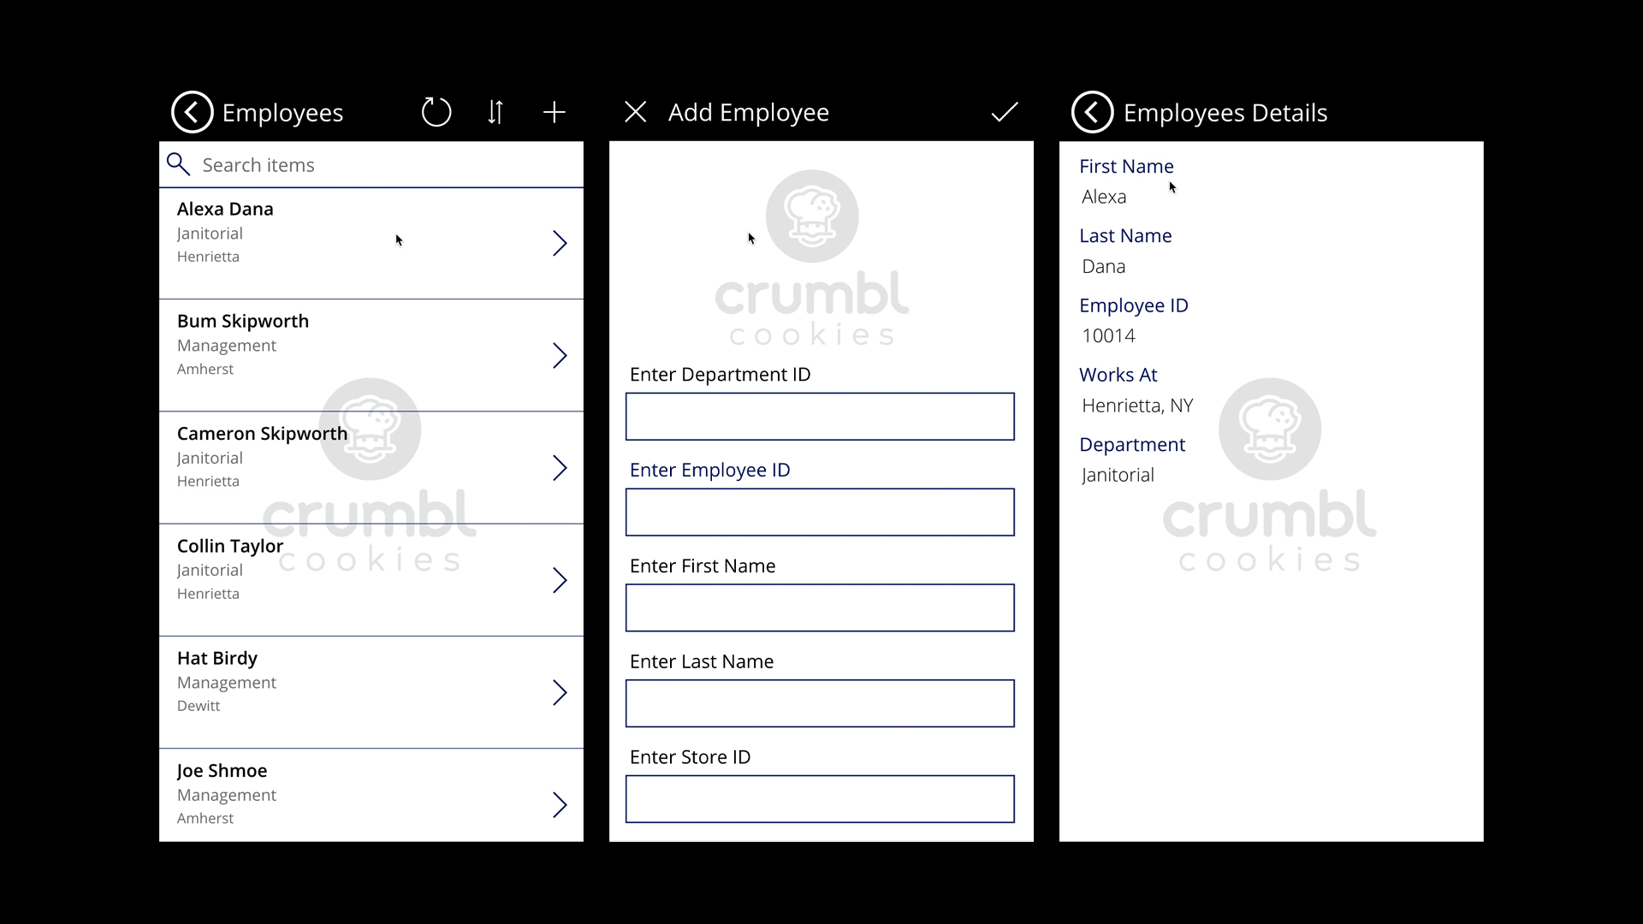

Slide 11
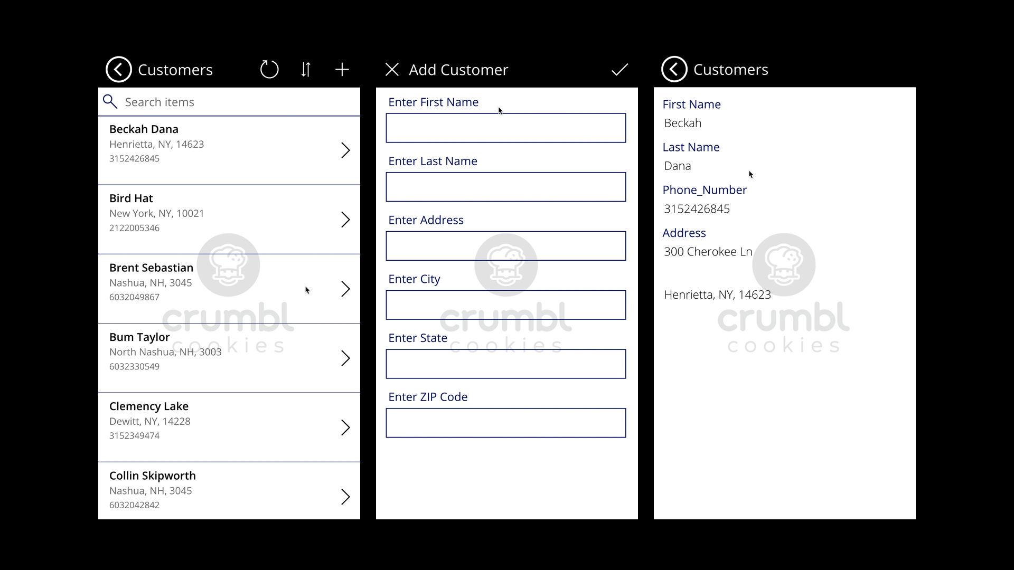

Slide 12
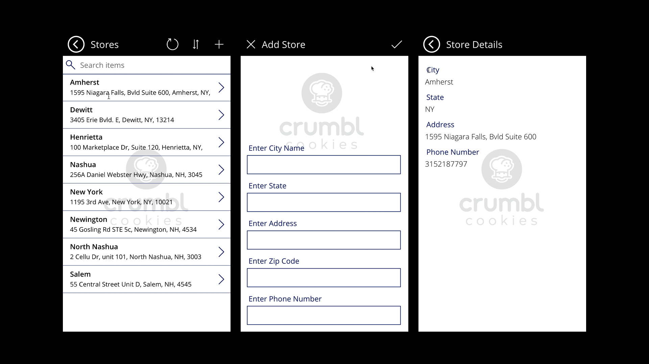

Slide 13
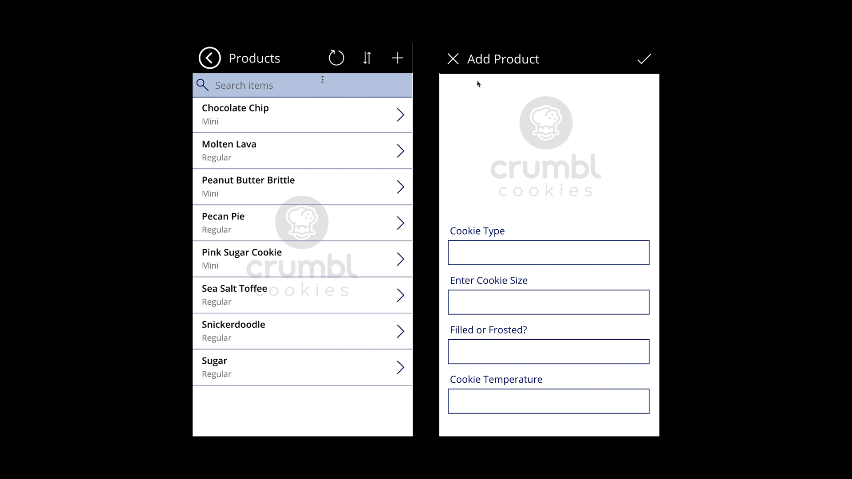

Slide 14
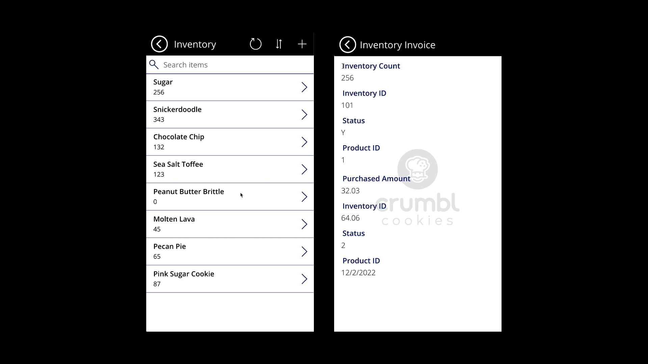

Slide 15
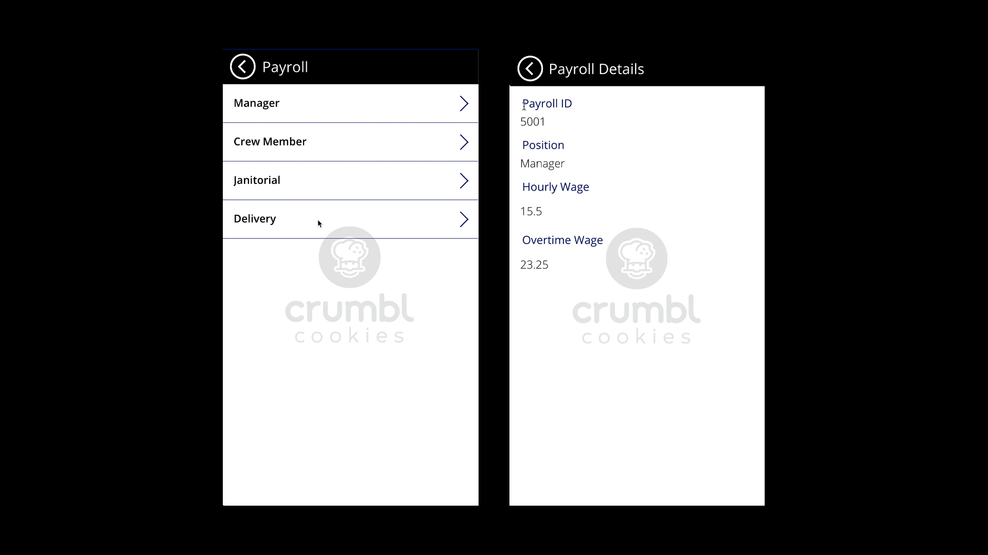

Slide 16
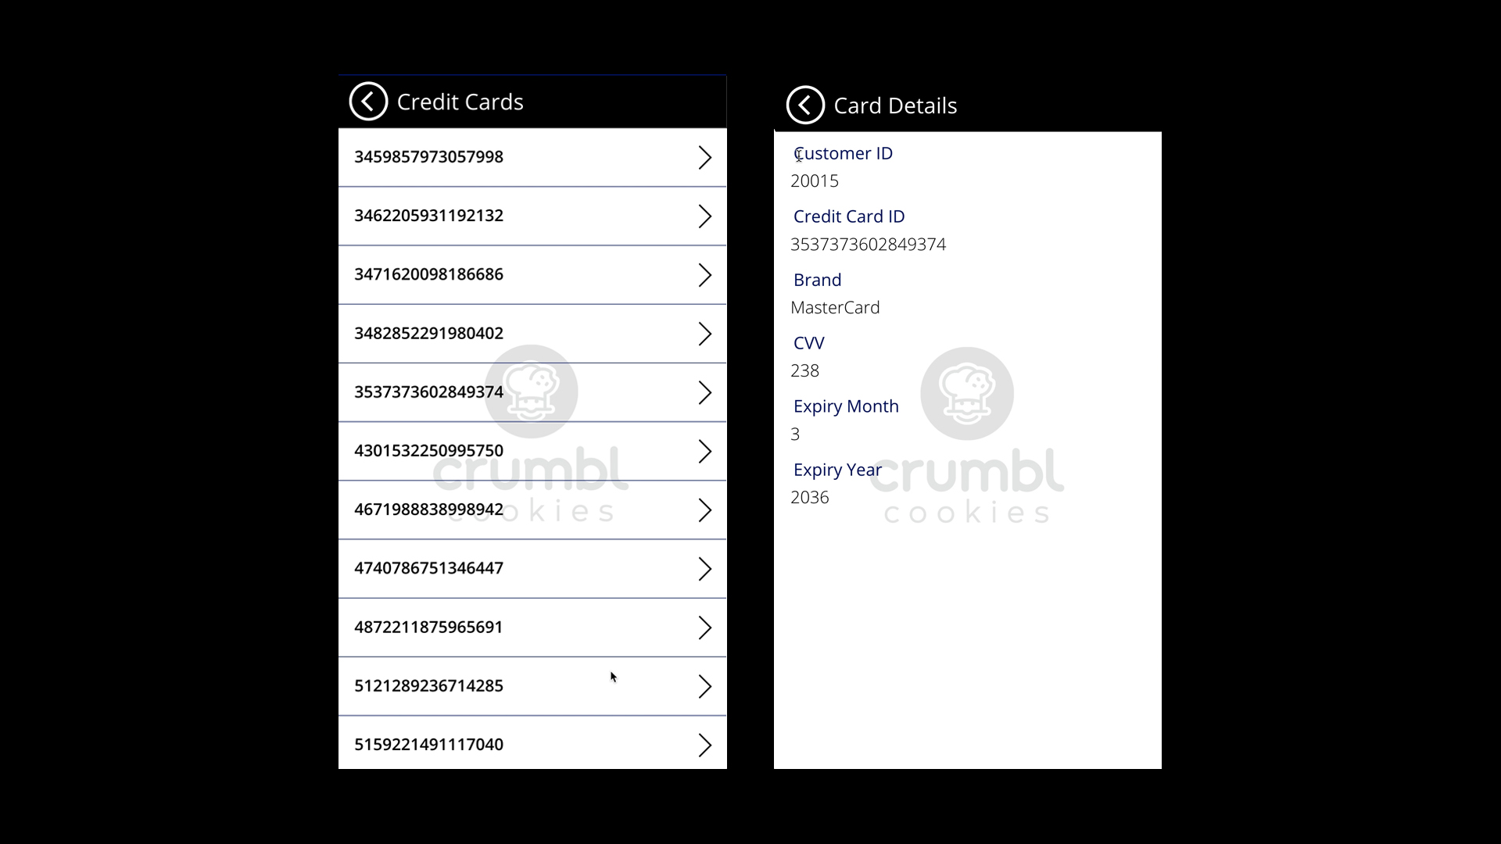

Slide 17
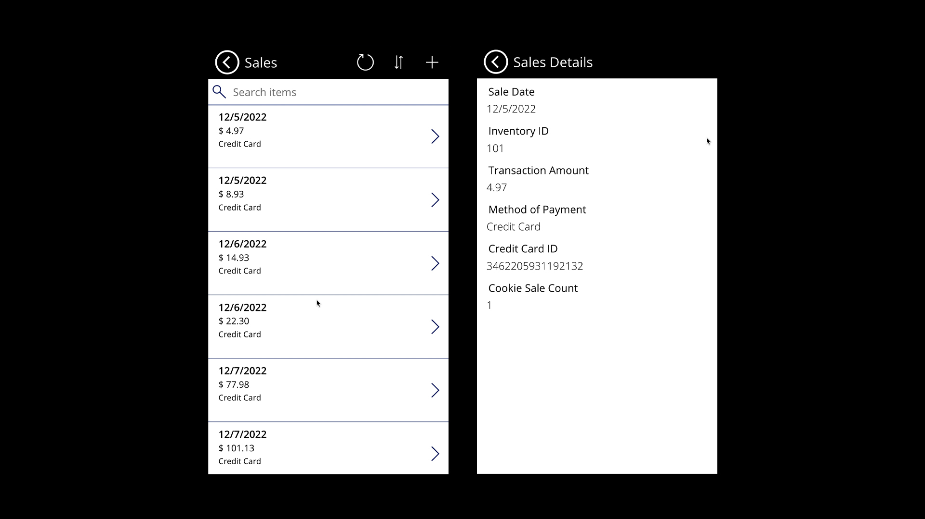

Slide 18
TABLE DATA

Slide 19
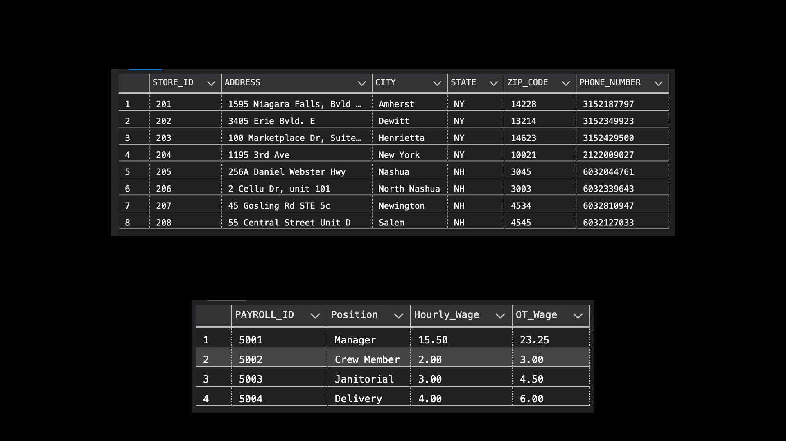
Stores
Payroll

Slide 20
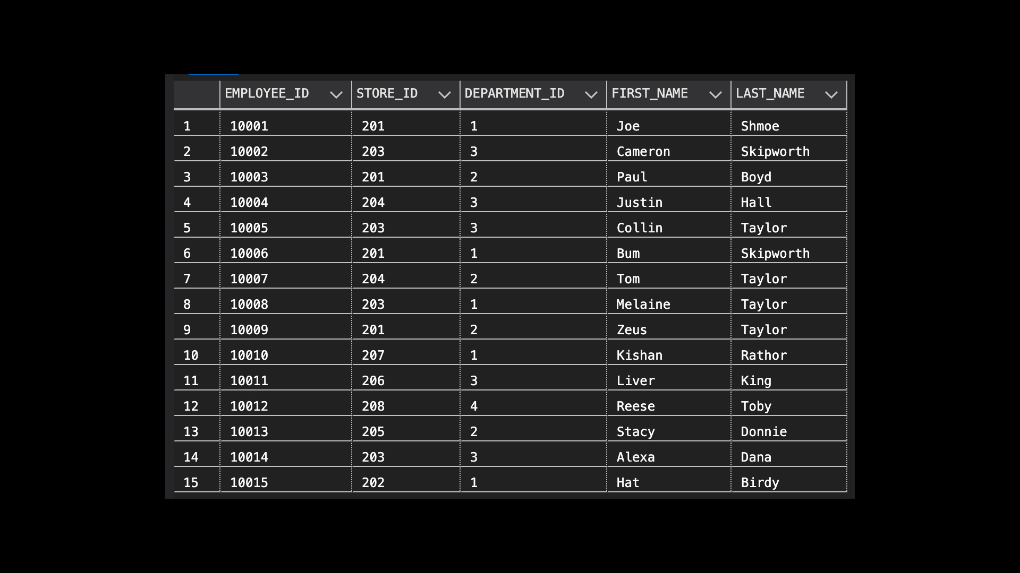
Employees

Slide 21
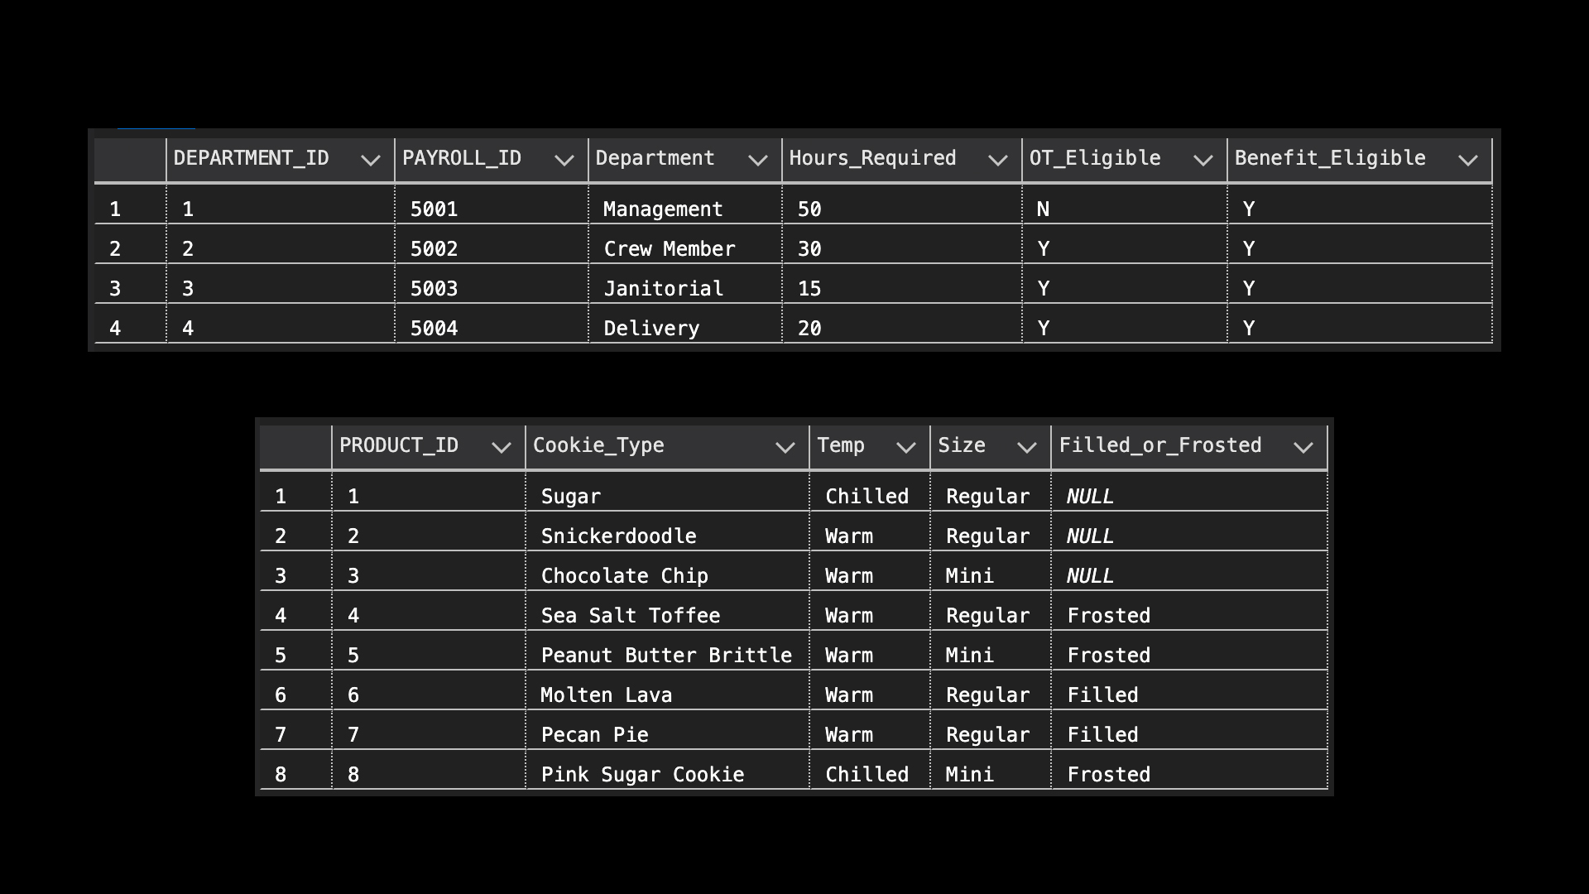
Department
Product

Slide 22
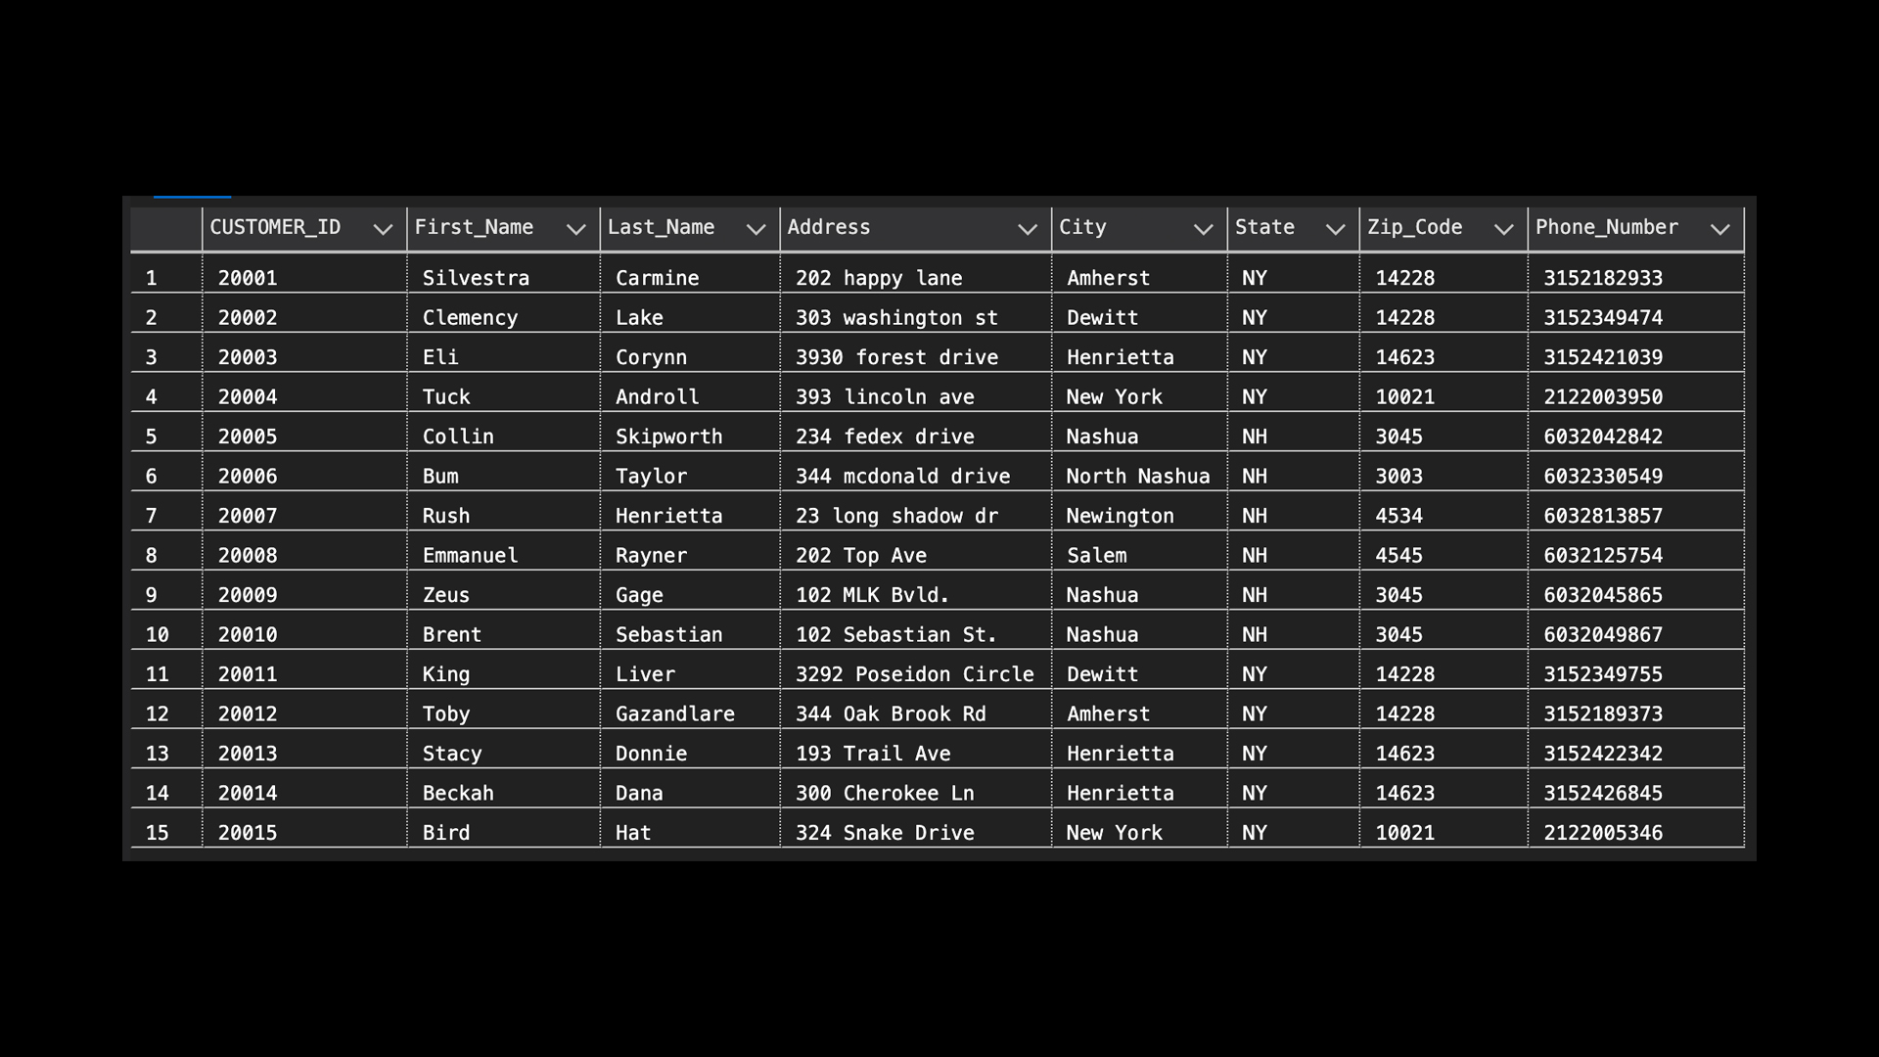
Customers

Slide 23
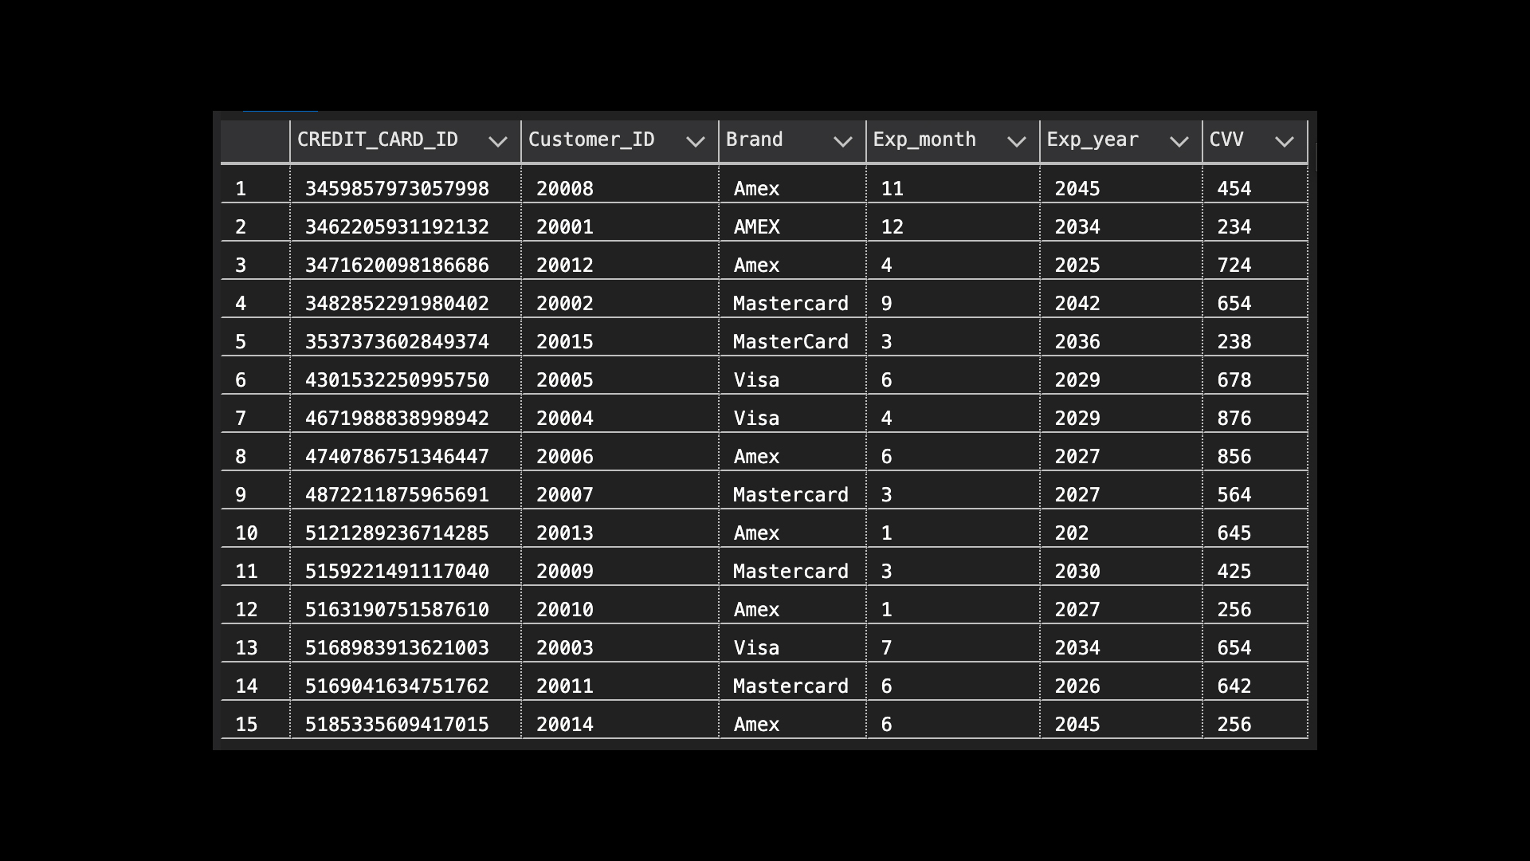
Credit_Cards

Slide 24
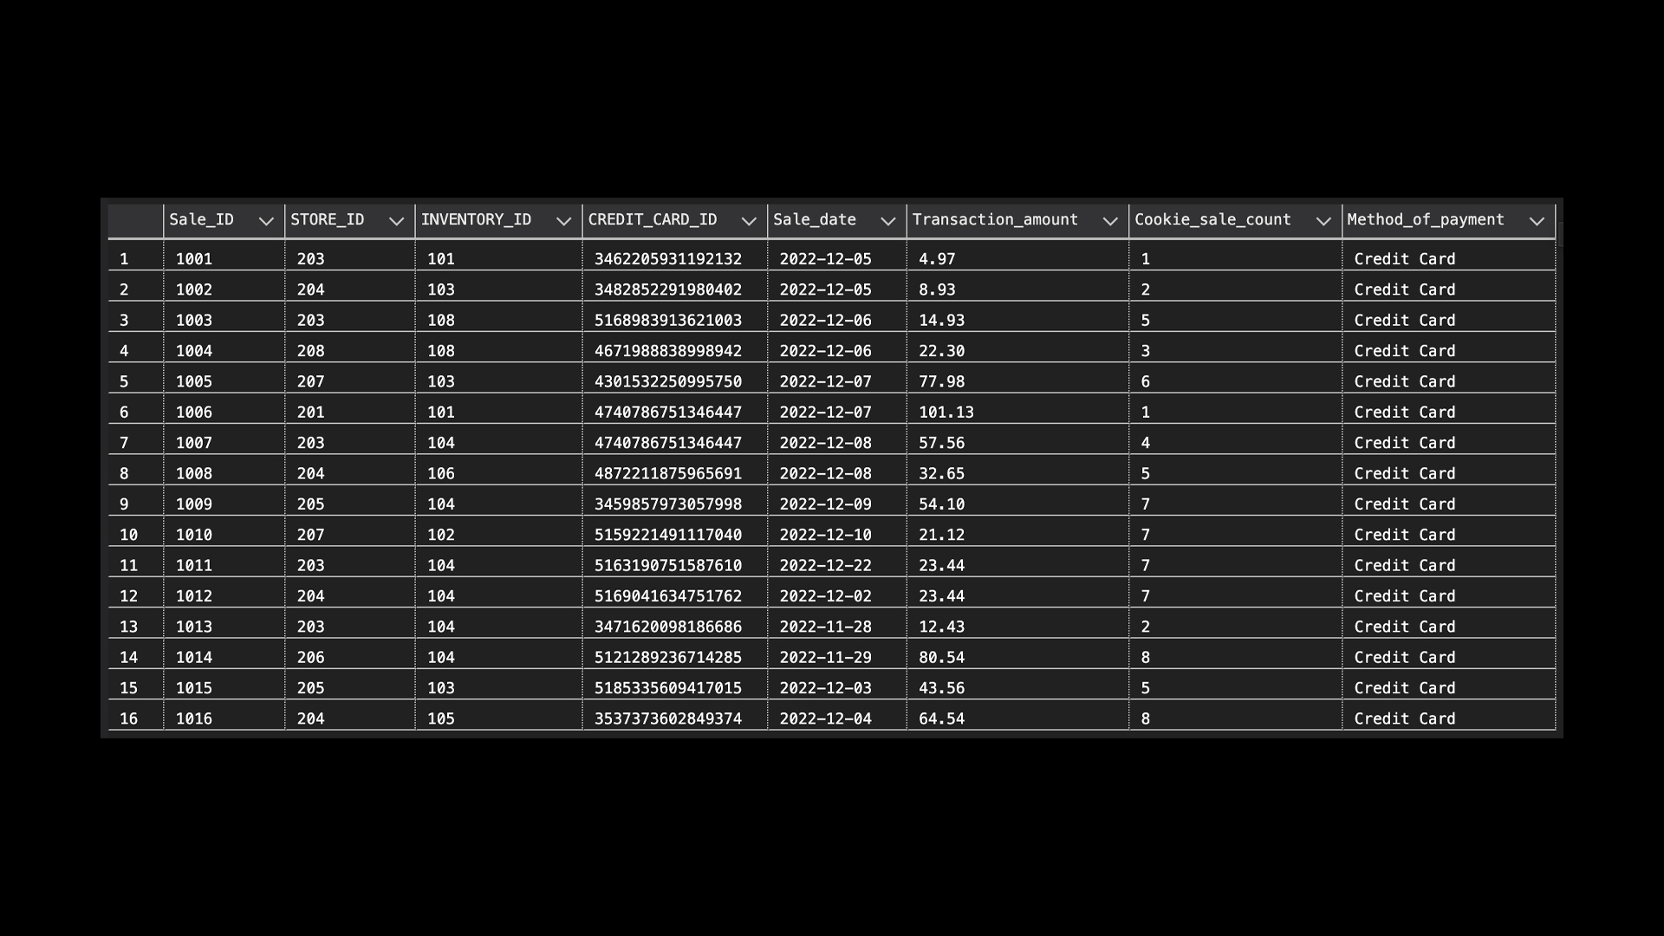
Cookie_Sales

Slide 25
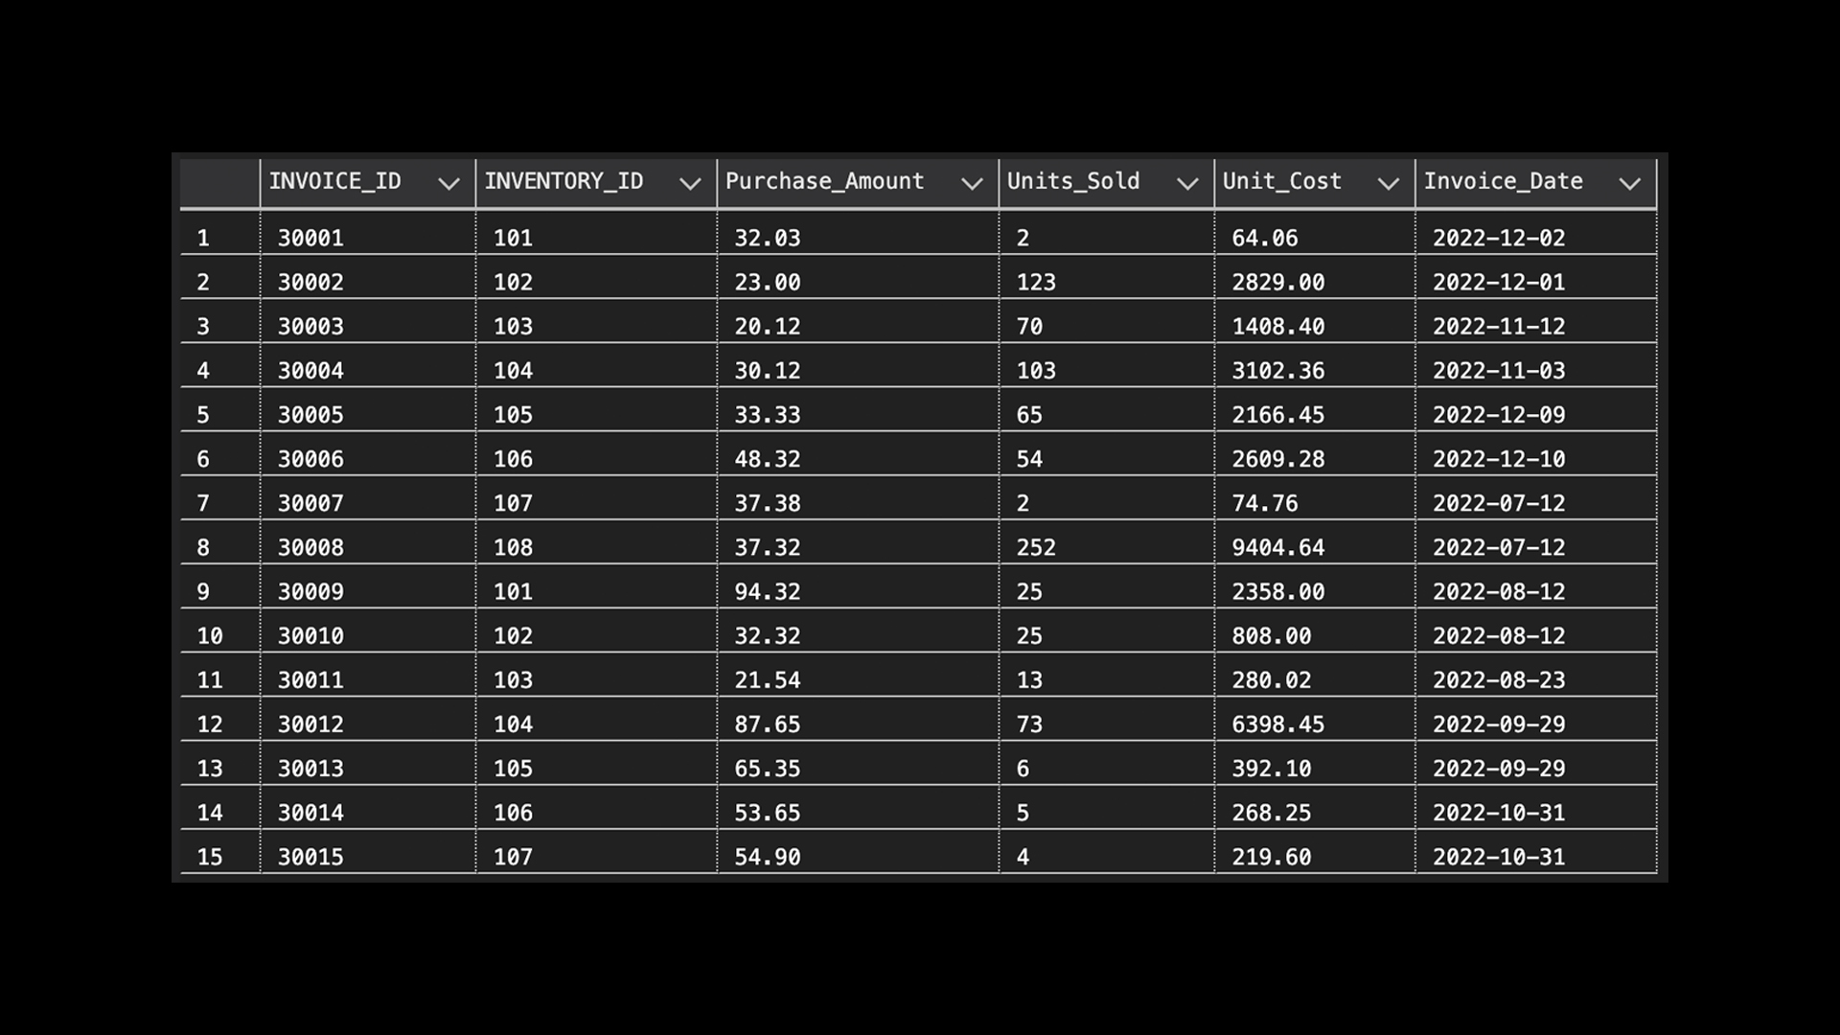
Inventory_Invoices

Slide 26
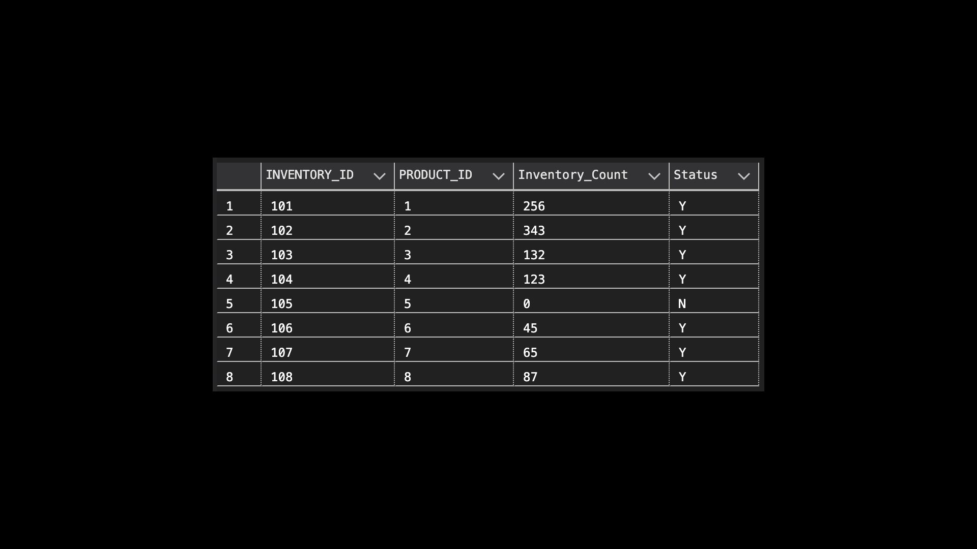
Inventory

Slide 27
CONCLUSION
System interfaces were created to satisfy the needs and desires of the market at the time.
This system will enhance existing performance and assist in problem solving.
With proper inventory management, you spend money on inventory that sells, so cash is always moving through the business.
In order to meet the requirements and wants of the market at the time, system interfaces were developed.
This system will aid in problem resolution and improve current performance.

Slide 28
THANK YOU

